Slide 1

BULLWHIP EFFECT IN SUPPLYCHAIN
MANAGEMENT
Submitted by-
ARYAN KUMAR
21135029
UNDER PROF : DR LAKSHYA

Slide 2
ABSTRACT
For organisations to keep up with the increasing demand, the supply chain requires efficiency. However, due to the unpredictable nature of demand, the bullwhip effect is a highly prominent in all industries. The role of AI and machine learning has been investigated in managing the risk which is accompanied by the bullwhip. The purpose of project is to study the effectiveness of various machine learning models in the prediction of the bullwhip effect. The bullwhip effect was studied using the KNN and XGBoost, Random Forest based on variables - Demand, Receive, Forecast, Net stock, Lead-Time-Delivery, Safety Stock, Order-up-to-Level, Order and cost.
Keywords: Bullwhip Effect, KNN algorithm, XGBoost, Supply Chain, Risk Management

Slide 3
SUPPLY CHAIN MANAGEMENT
Supply chain consists of a series of activities involving many organizations through which material moves from the initial supplier to the final customer.
It involves various organizations like suppliers, manufacturers, distributors, and retailers.
Supply chain management refers to control of the flow of goods and services. It includes all the processes that transform raw materials into finished goods.
SCM provides right product at right time, right place and at right cost to customer.

Slide 4
Key Component of SCM
Planning | Build strategy , plan schedules, demand forcasting.
Sourcing | Finding supplier and establish relationship
Production | Managing manufacturing process
Inventory Management | Monitor stock level ,minimize holding cost, economic order quantity
Logistics | Transportation cost and warehouse and distribution cost
Customer Service | Responding to customer queries

Slide 5
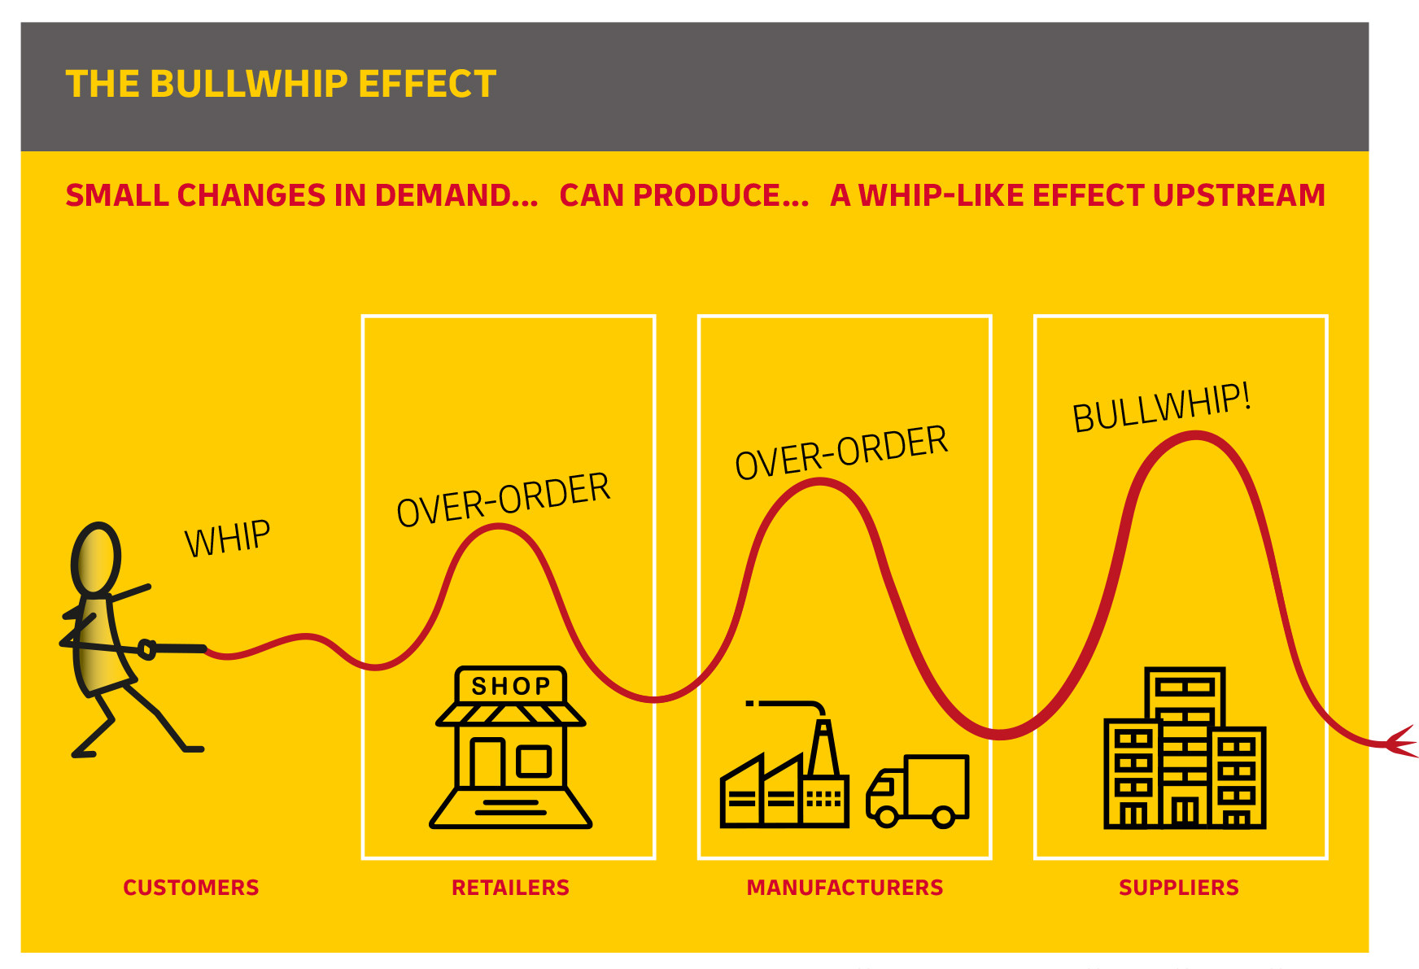
BULLWHIP EFFECT
The Bullwhip effects refers to the phenomenon where smaller fluctuations in customer demand can lead to progressively larger fluctuations in demand order placed upstream.
This is also known as demand Amplification.
This phenomenon is popularly known as Forrester effect.

Slide 6
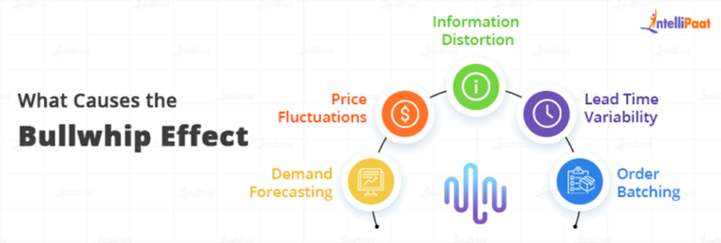
CAUSES OF BULLWHIP EFFECT
Inaccurate Demand Forcasting
Lack of Information
Order Batching
Price Fluctuations
Improper Inventory Mangement

Slide 7
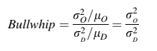
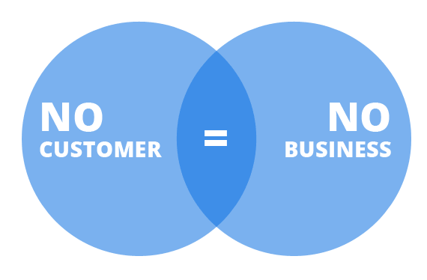


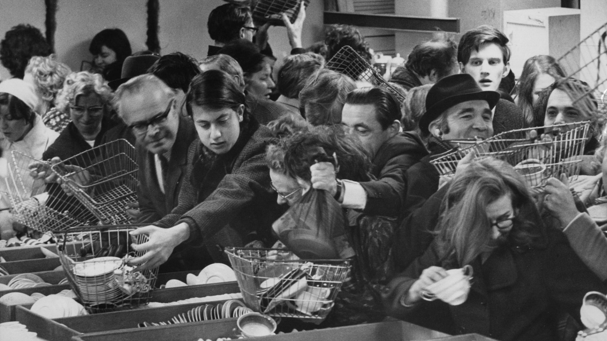
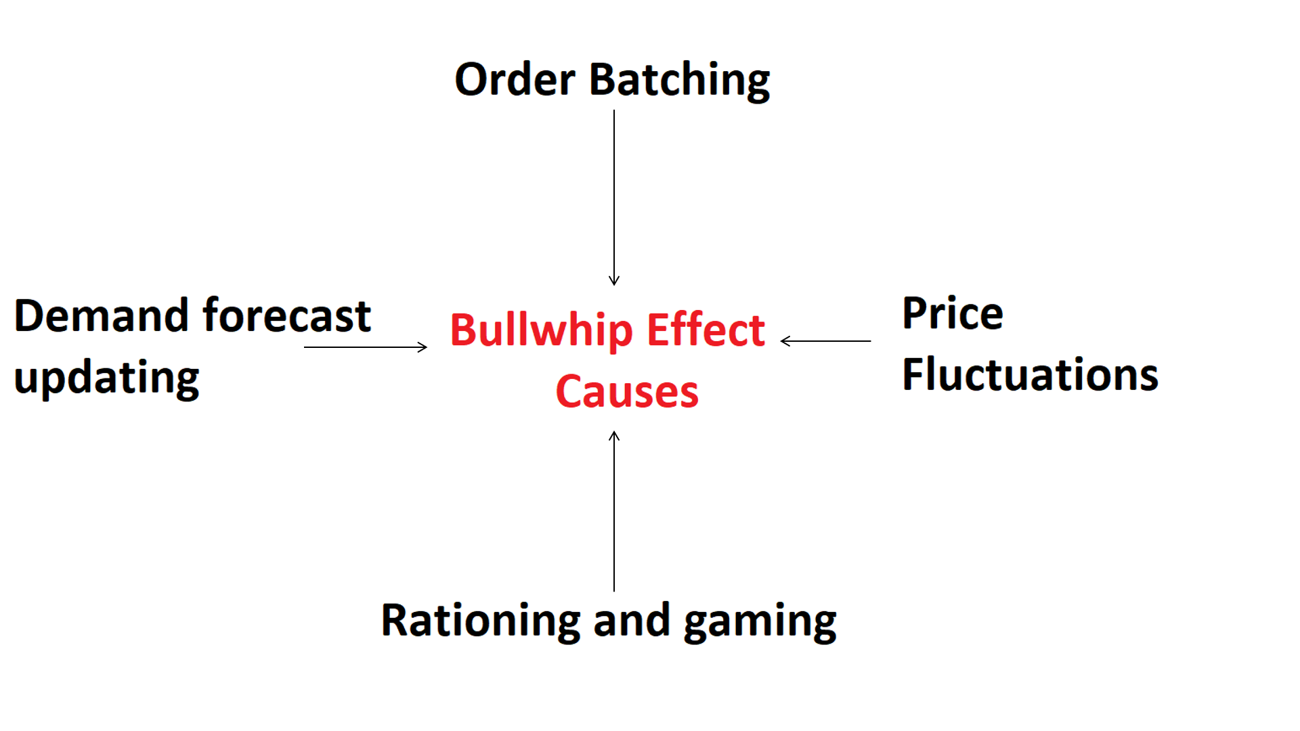
Measuring the bullwhip effect
< 1
“ Isolation effect “
> 1
“ Variance Amplification “

Slide 8
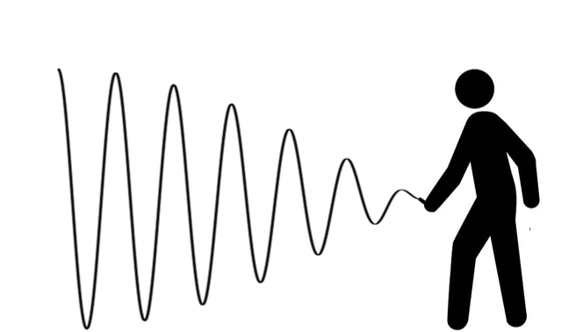
FEATURES AFFECTING BULLWHIP EFFECT
FEATURES AFFECTING BULLWHIP EFFECT
based on extensive literature review*
Demand
Receive
Forecast
Net Stock
Lead Time Delivery
Safety Stock
Order Up to Level (OUT)
Order
Cost

Slide 9
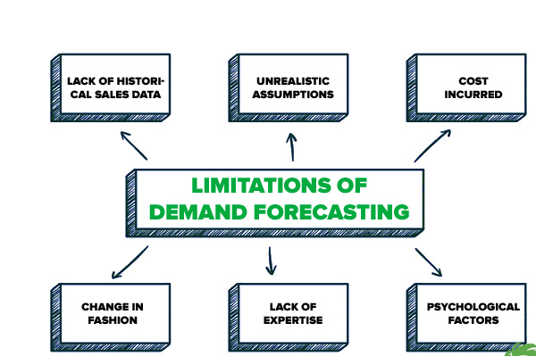
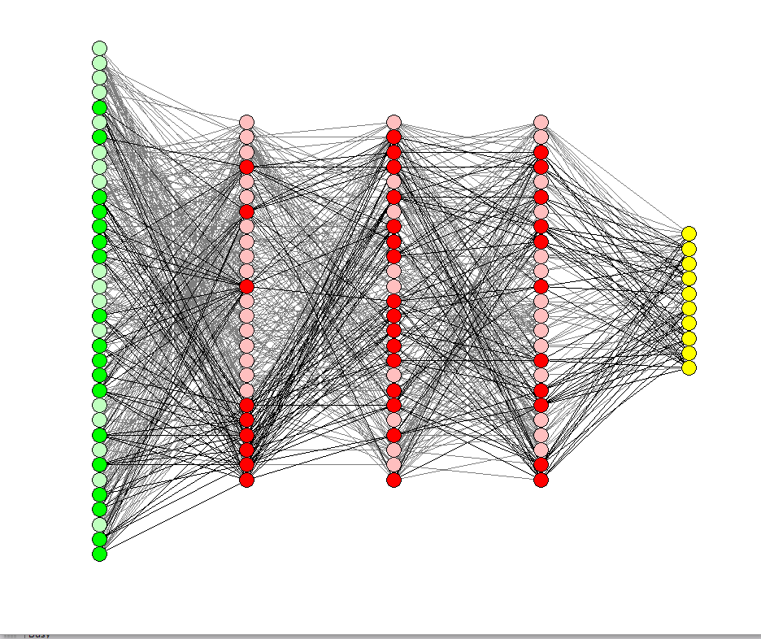
Conventional methods
1. Rationing game ( Forecasting based)
- Naïve method
- Moving average method
- Weighted moving average method
2. Information Sharing
Proposed method
Machine Learning based
Predicts Bullwhip Effect with Demand , Lead time,
Net stock, Order, Order Up to Level
Receive, Safety stock (SS)

Slide 10
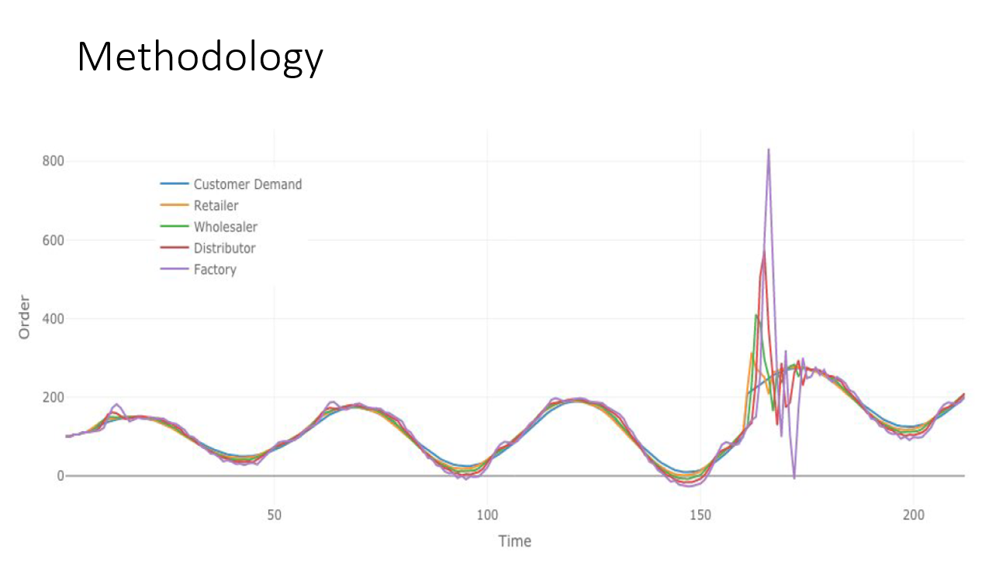
Methodology
Data Collection
Data Exploration
Data Cleaning
Data Processing
Data Scaling
ML Modelling
Listing flaws of the model

Slide 11
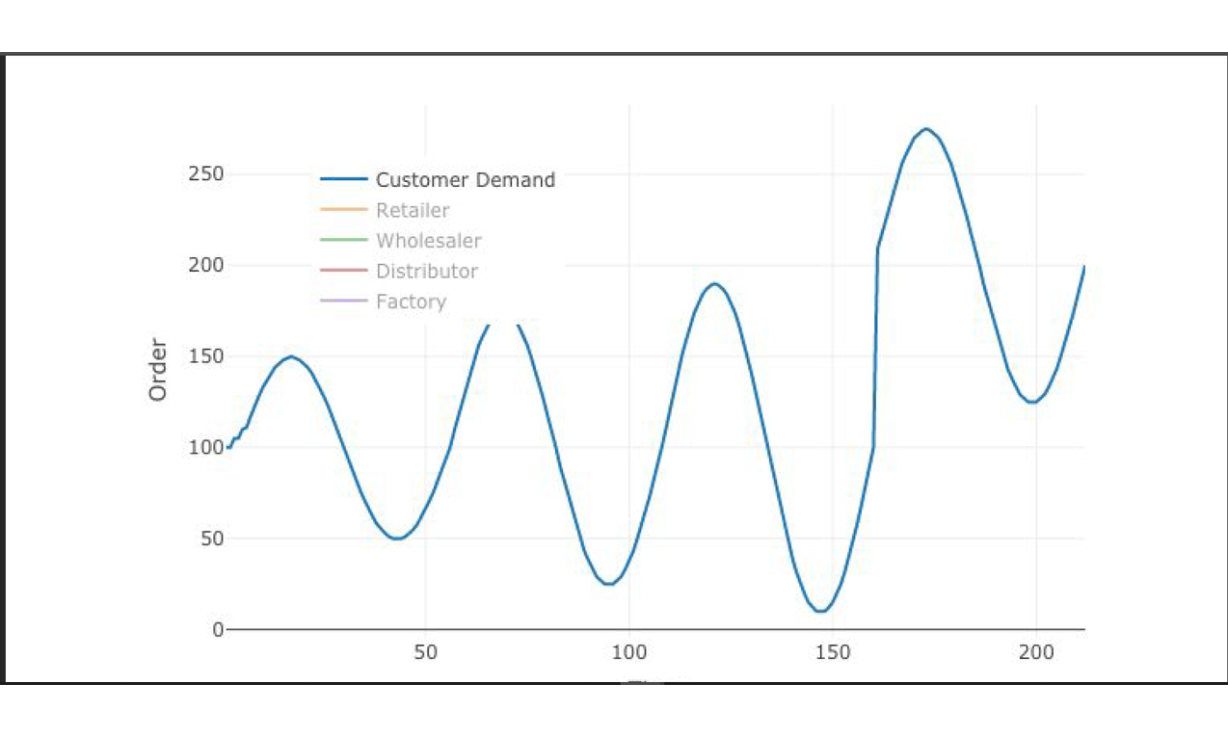
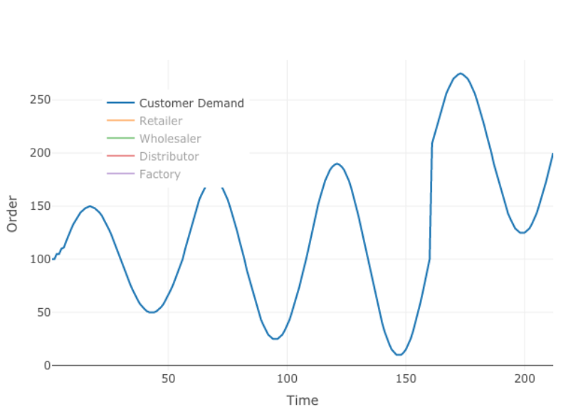
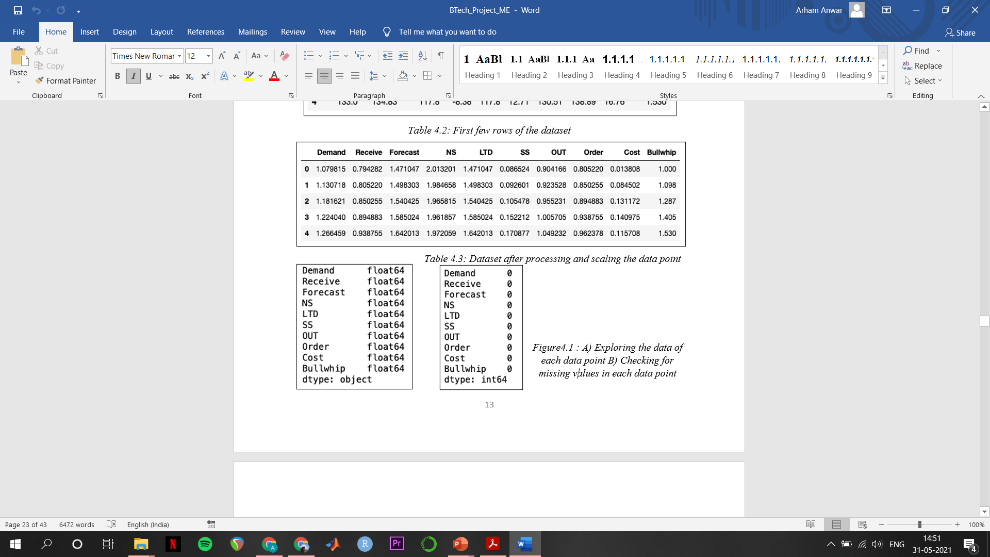

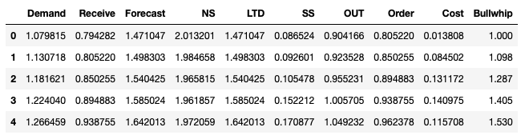
Data Exploration
Data Cleaning
Data Processing
MIT
Bullwhip Game

Slide 12
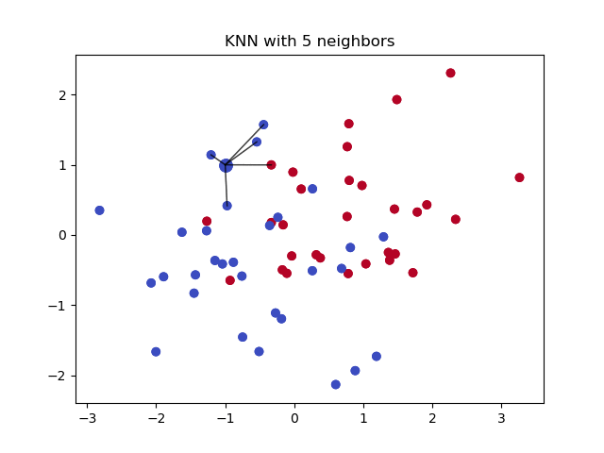
Models Used
KNN
Random Forest
XG BOOST

Slide 13
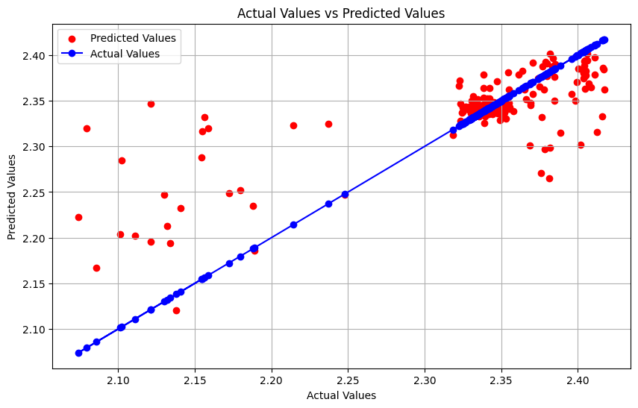
KNN
K-Nearest Neighbours is an instance-based machine learning algorithm which stores history of all available cases and uses the information to classify new cases based on the criteria of similarity measure or distance function, wherein the K value represents the number of neighbours.

Slide 14
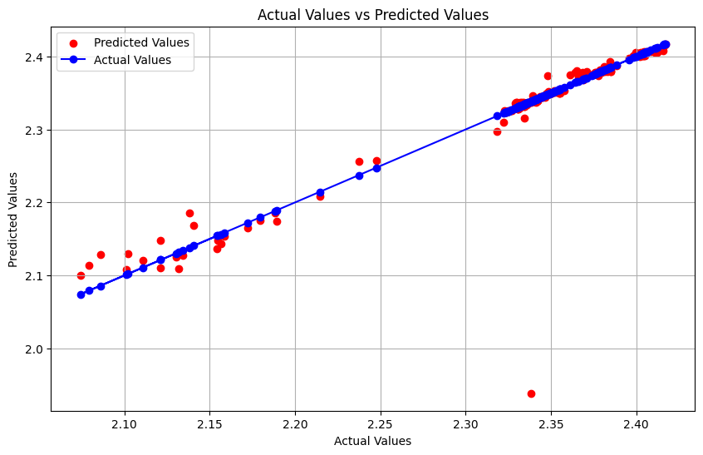
RANDOM FOREST
The Random Forest Regressor is a powerful ensemble learning method used for regression tasks. It operates by constructing multiple decision trees during training and outputting the average of their predictions for regression tasks. This technique helps to improve the model's accuracy and robustness compared to individual decision trees.. Random Forest, unlike K-Nearest Neighbours, performs well even with missing values. Low computation of decision trees make it suitable for oceans of data as seen in several industries.

Slide 15
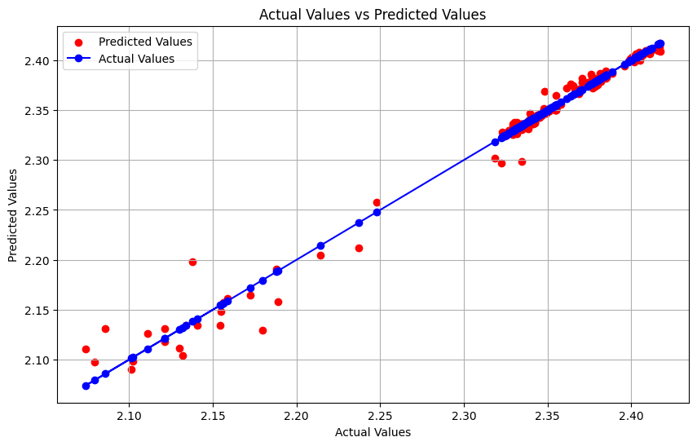
XG BOOST
XGBoost (Extreme Gradient Boosting) is a powerful and efficient open-source implementation of the gradient boosting framework. It has become popular due to its performance and speed in various machine learning competitions and real-world applications. Here are some key details about XGBoost:
Gradient Boosting Algorithm
Regularization
Handling Missing Values

Slide 16
Mean Squared Error (MSE)
XGBoost has the lowest MSE, indicating that it has the smallest average squared difference between predicted and actual values. This suggests that XGBoost's predictions are the closest to the actual values among the three models.
Random Forest Regressor has a higher MSE than XGBoost but is still significantly lower than KNN.
KNN has the highest MSE, suggesting its predictions are less accurate compared to the other two models.
R-squared (R²):
XGBoost has the highest R² score of 0.9831641633223367, indicating that it explains approximately 98.32% of the variance in the data. This suggests a very high level of accuracy.
Random Forest Regressor has a decent R² score of 0.8423394724441486, explaining about 84.23% of the variance, which is good but not as high as XGBoost.
KNN has the lowest R² score of 0.5602800163795265, explaining only 56.03% of the variance. This indicates a moderate level of accuracy, but much lower than the other two models
3. Mean Absolute Error (MAE):
XGBoost has the lowest MAE, indicating the smallest average absolute errors between predicted and actual values. This again suggests that XGBoost's predictions are the most accurate.
Random Forest Regressor has a higher MAE than XGBoost but lower than KNN, indicating moderate prediction errors.
KNN has the highest MAE, indicating the largest average errors, suggesting less accurate predictions compared to the other two models

Slide 17
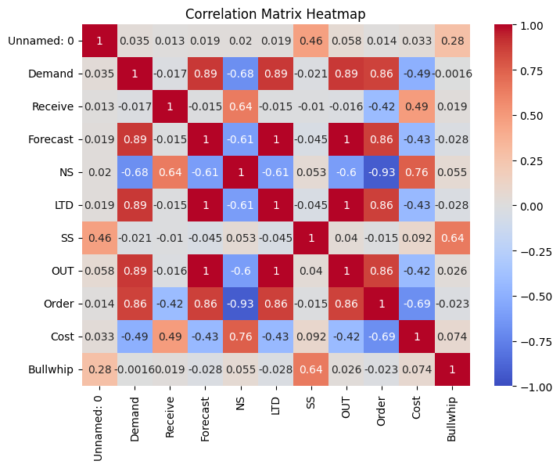
Research Results
Constructed correlation matrix between the various inputs and bullwhip was found to be multi-correlational
Random Forest Regressor performs well but is not as accurate as XGBoost. It has a reasonably high R² score and lower error metrics than KNN, making it a good choice but not the best in this comparison.
KNN performs the worst among the three algorithms, with the highest error metrics and the lowest R² score. It indicates that KNN's predictions are less accurate and it explains less variance in the data compared to XGBoost and Random Forest.
XGBoost clearly outperforms the other two algorithms in all three metrics (MSE, R², MAE), indicating that it provides the most accurate and reliable predictions. Its high R² score and low error metrics suggest that it has the best fit to the data and makes the most precise predictions.

Slide 18

CONCLUSION
Coordination and collaboration -- a plausible remedy to the demand amplification problem, albeit idealistic
In absence of integration among partners the increase in accuracy of demand information will help to reduce the bullwhip effect
.
Research results show promise in AI bullwhip use case, Future research could be directed towards genetic algorithm, fuzzy logic etc in Bullwhip

Slide 19
THANK YOU

